Slide 1


Just because
I CAN’T SPEAK,
Doesn’t mean
I don’t have
ANYTHING TO SAY !!!!
Let Us Make A Bridge!
Notes:
A language is an entirely human method for communicating thoughts and feelings. As normal people, we can talk with each other and can share our ideas, feelings…….what you think about deaf person? He can not speak. Is that mean , he does not have any thing to say us? No…… he is a person who the 'differently-able' . That’s why he cant talk with us. So there is a problem. There is a gap. Lets talk what we can do for them.

Slide 2


Project Proposal Presentation
Intelligent assistant for hearing impairers to interact with the society
IT 14114618 – J.P.C.N. Jayalath

Slide 3
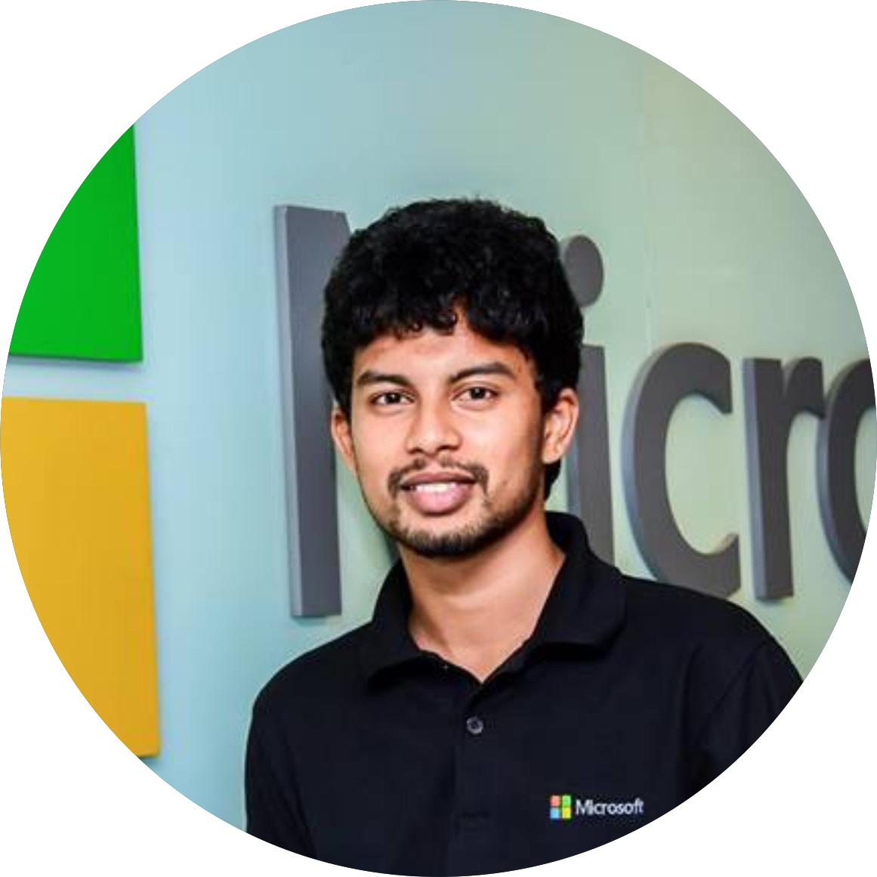
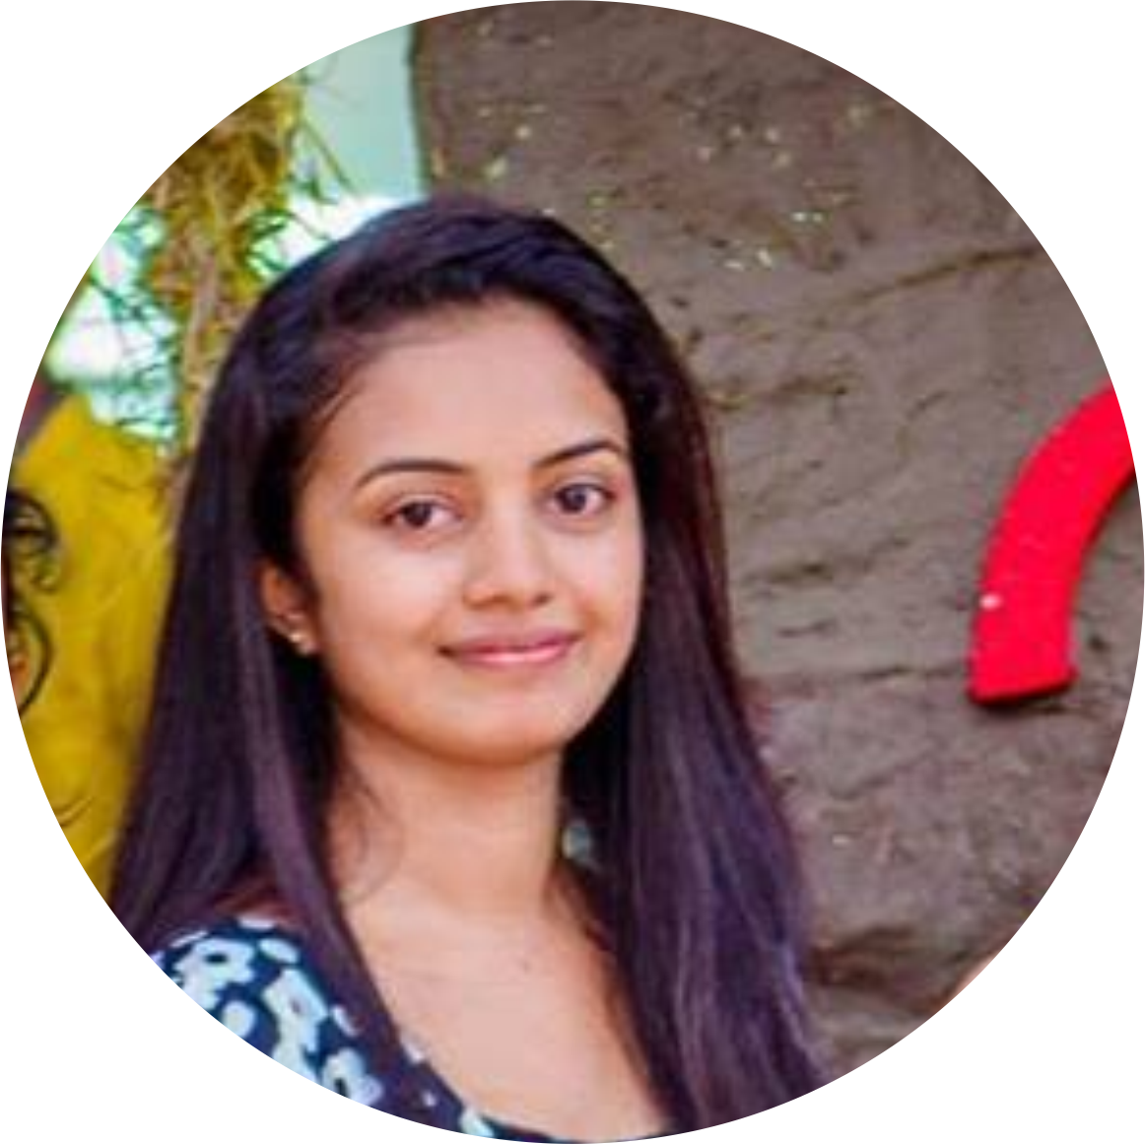
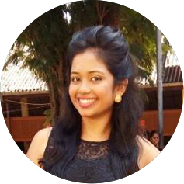
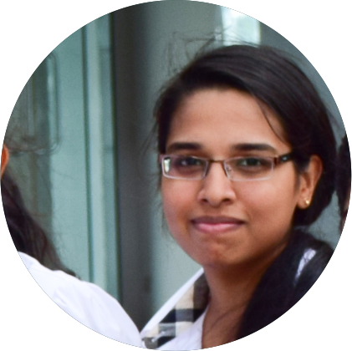
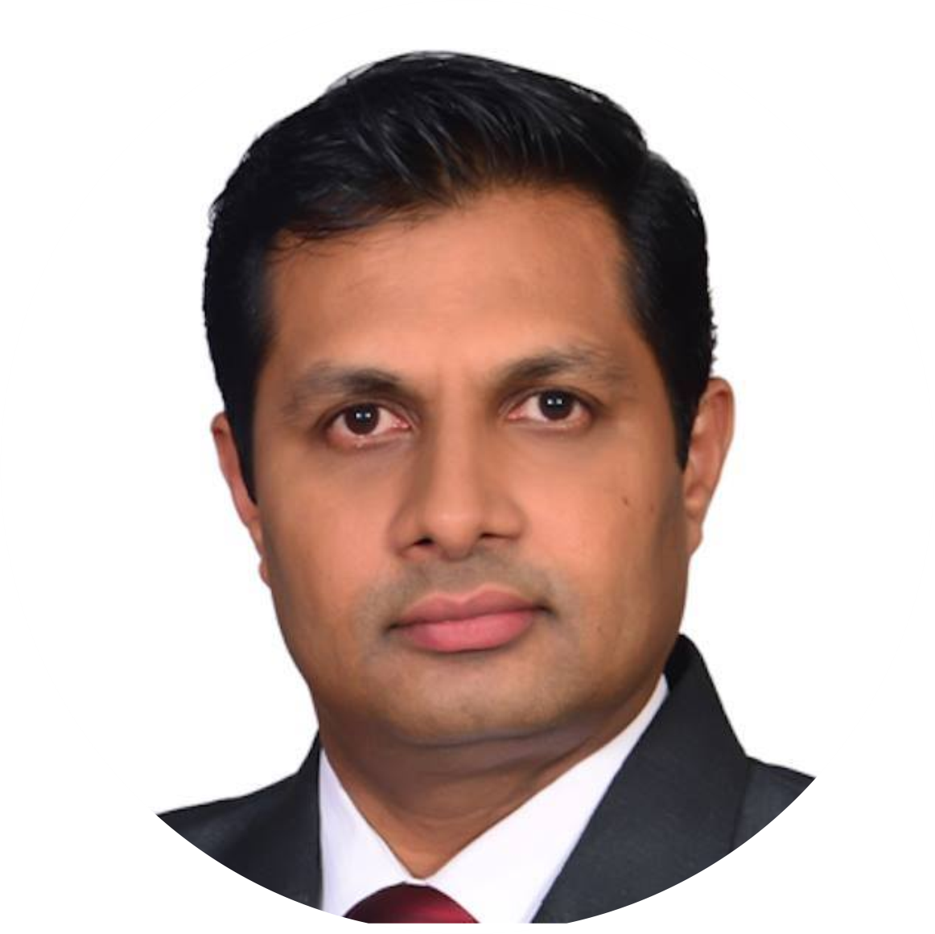
Group Details
Group No - 17-092
IT14029264
IT14114618
IT14106866
IT14076176
S.Y.M. Perera
J.P.C.N. Jayalath
W.S. Tissera
A.M.O.P. Bandara
Supervisor- Prof. Samantha Thelijjagoda
IT 14114618 – J.P.C.N. Jayalath

Slide 4

Overview
Introduction
Research Problem
Background Study
Objectives
Project Overview
Technologies
Business Plan
Q&A
IT 14114618 – J.P.C.N. Jayalath

Slide 5
Introduction
IT 14114618 – J.P.C.N. Jayalath

Slide 6
Do Hearing impairers want to interact with others?
YES! They are..
♥
IT 14114618 – J.P.C.N. Jayalath
Notes:
As humans we like interact with others. It is common for deaf people.

Slide 7

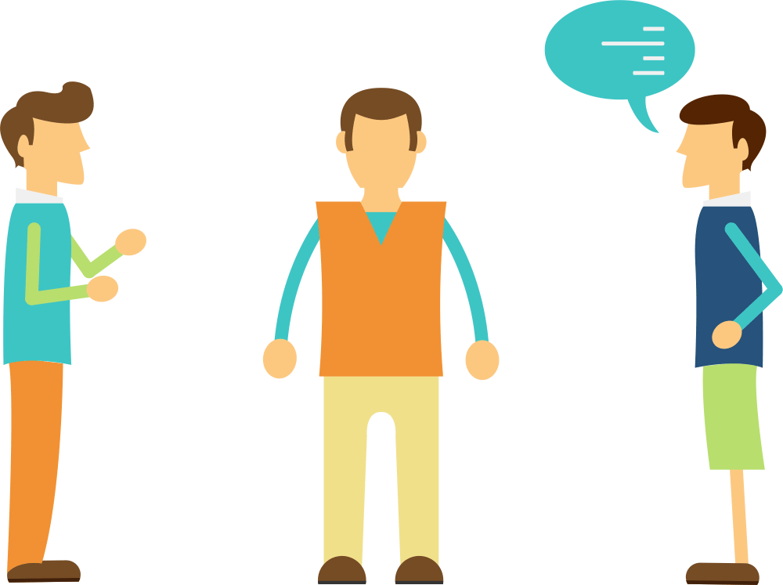
Existing communication
methods
Through an Interpreter
IT 14114618 – J.P.C.N. Jayalath
IT 14114618 – J.P.C.N. Jayalath
Notes:
Sign language, specially formulated for the deaf people, makes use of finger spellings, body language, lip pattern and manual communication, to convey the meaning. It mainly involves the use of orientation and movement of hands. So, to the understand that deaf person's language normal people want an interpreter.

Slide 8
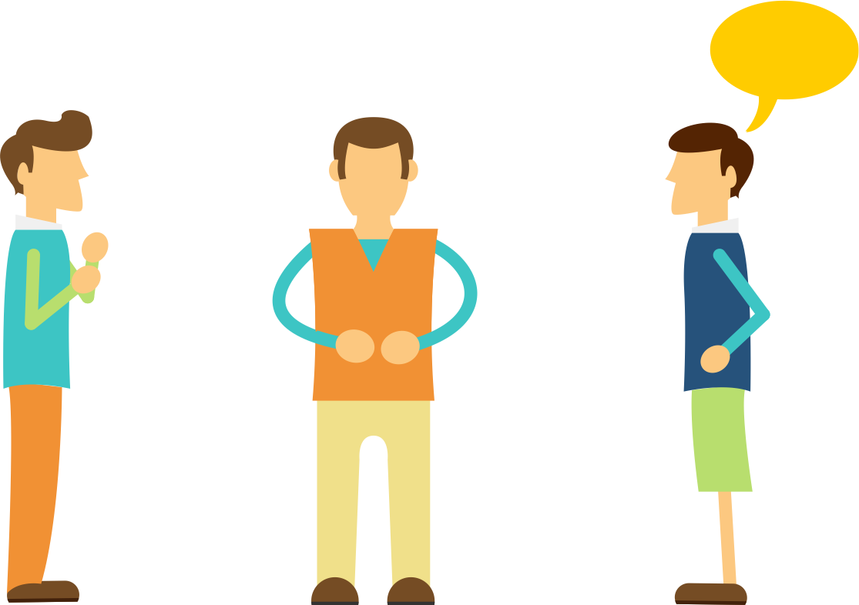
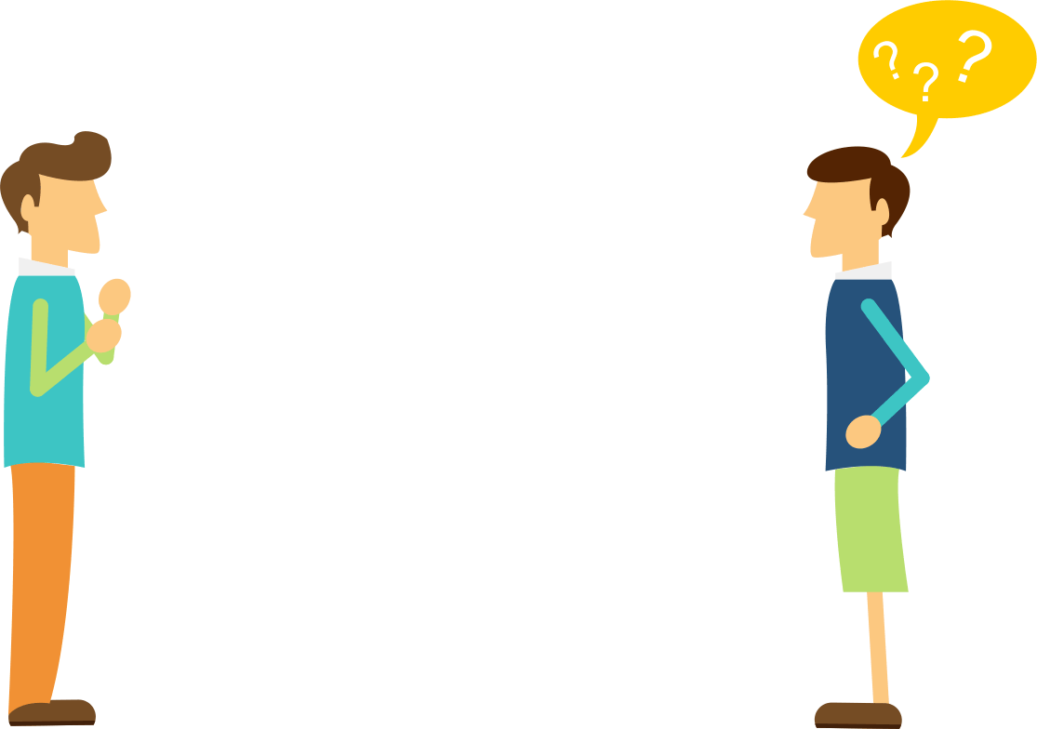
What will go wrong without an Interpreter?
IT 14114618 – J.P.C.N. Jayalath
IT 14114618 – J.P.C.N. Jayalath
Notes:
When we have not an interpreter definitely we are getting trouble. Because we cant understand what our deaf friend try to say us.

Slide 9

Research Problem
Many deaf people feel awkward or become frustrated trying to communicate with ordinary people, especially when no interpreter is available. (SaraEgo1,Communication between deaf and hearing society, 2014)
There’s no way to share emotions and feelings unless they meet each other. (M. Alimohammadi and M. Zahedi, Communication between deaf and hearing children using statistical machine translation, 2015 )
Deaf community discourage to be social. (M. Alimohammadi and M. Zahedi, Communication between deaf and hearing children using statistical machine translation, 2015 )
Deaf people unable to get any support from ordinary people since there isn’t any common communication mode.
?
IT 14114618 – J.P.C.N. Jayalath

Slide 10

Background Study
Related Research Papers
Communication between deaf and hearing society, SaraEgo1 (2014)
Toward a mobile service for hard of hearing people to make information accessible anywhere, M. Boulares and M. Jemni (2013)
Making ICT accessible for the deaf 2013 IST-Africa Conference & Exhibition, Nairobi, G. Yeratziotis and D. Van Greunen (2013)
Hand Gesture Recognition, (IJITR) International Journal of Innovative Technology and Research, Volume, J. Siby, H. Kader and J. Jose(2015)
Unicode Sinhala and phonetic English bi-directional conversion for Sinhala speech recognizer, M. Punchimudiyanse and R. G. N. Meegama (2015)
?
IT 14114618 – J.P.C.N. Jayalath

Slide 11
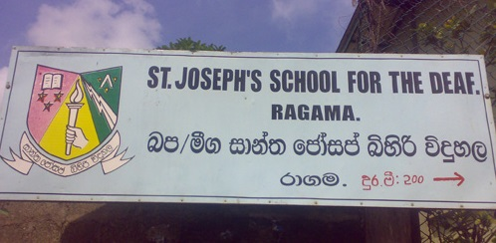

Background Study
Discussions & Interviews
Prof. Samantha Thelijjagoda
Head/Department of Information Systems Engineering(SLIIT)
Rev. Sister Nirmali
Principal - St. Joseph's School For The Deaf, Ragama
Mr. Kasun Jayathunga
Founder & CEO at “Ahanna(Listening) Foundation”
Ms. Rajitha Viduransi
Interpreter for the Deaf, “Ahanna(Listening) Foundation”
?
IT 14114618 – J.P.C.N. Jayalath

Slide 12


What we offer….
IT 14114618 – J.P.C.N. Jayalath
Notes:
We offer “Sanwada” as a solution that problem.

Slide 13

Main Objective
To deliver excessive support by enabling hearing impaired people to communicate with others and actively interact with the society.
IT 14114618 – J.P.C.N. Jayalath

Slide 14
Specific Objectives
To identify many Hearing-impairers prefer to communicate with Sign languages which leads to the communication barrier with ordinary people. Subsequently Deaf people become frustrated to interact with the society.
To establish the pathway for investigation, research papers and documents were surveyed mostly. Furthermore, the real obligation was discovered through the interviews conducted with students of Deaf School.
To determine the use of mobile applications for deaf people can be observed as a diligence that allows them regardless to utilize to any need of learning and communication at any time anywhere.
IT 14106866 – W.Shenali Tissera

Slide 15
Specific Objectives
To emerge the application in Sinhala language to reach the Sri Lankan deaf community in an effective way.
To advance the text message to a Graphic Interchange Format (GIF) to get the message in sign language with more accurate and attractive manner.
To allow the generation of own sign language using 2D model provided which makes hearing impairers more comprehend about the message they want to direct.
To enhance Sinhala voice recognition algorithm.
To interact with the most popular social media like Facebook Messenger.
?
IT 14106866 – W.Shenali Tissera
15

Slide 16


Existing Systems
Face to face communication
Supports for English Sign language
Speech to Text translation
System has Note Speak Listen for Deaf app functionality
?
Communicate over moderate distances
Input text via voice recognition or the keyboard
Using a network connection rather than Bluetooth
Connection could be an Intranet or even a connection via the Internet
IT 14106866 – W.Shenali Tissera
16

Slide 17



Existing Systems
Web based application
Sinhala sign language
Intention to spread pure Buddhism among Deaf community
?
Interpret the processed signal and map the signal to words
Recognizing and interpreting voice
Achieve speech understanding
System used for children
Game based learning system
Identify individual signs and phonetics though videos and images
IT 14106866 – W.Shenali Tissera
17

Slide 18



Comparison with Available systems
?
Product Feature | Deaf Chat | Deaf hearing chat | Nihanda | Ahanna | Kathana | Sanwada
Speech to Sign translation (Sinhala)
Text to Sign translation – Sinhala & Singlish
Sign language to GIF
Sign using 2D Model
Stickers & Animated stickers
Interaction with Facebook messenger
Mobile Application
?
18
IT 14106866 – W.Shenali Tissera
Notes:
Describe comparison.

Slide 19
Is it possible….
YES!
?
Using a mechanism it’s possible to convert Text or Voice to Sign language and demonstrate it as a GIF format.
IT 14076176 – A.M.O.P.Bandara
Notes:
We are going to use mechanisum to conert voice or text to sign language to communicate through our app..

Slide 20


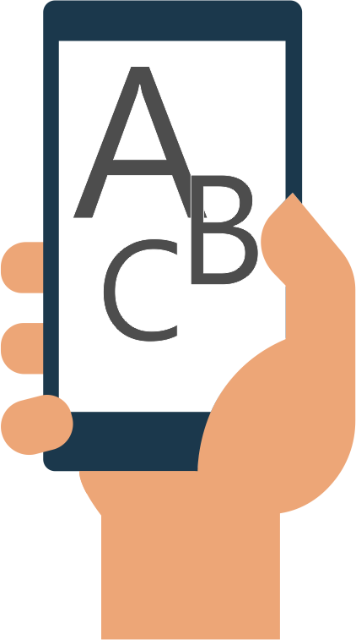

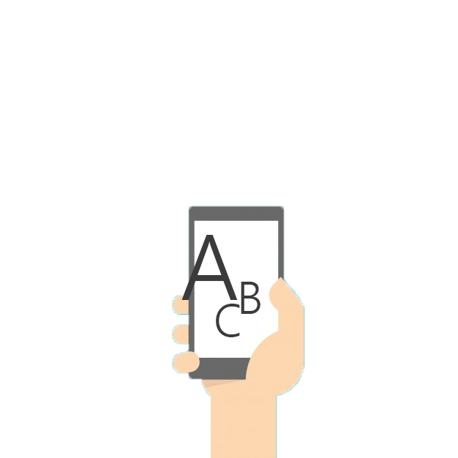
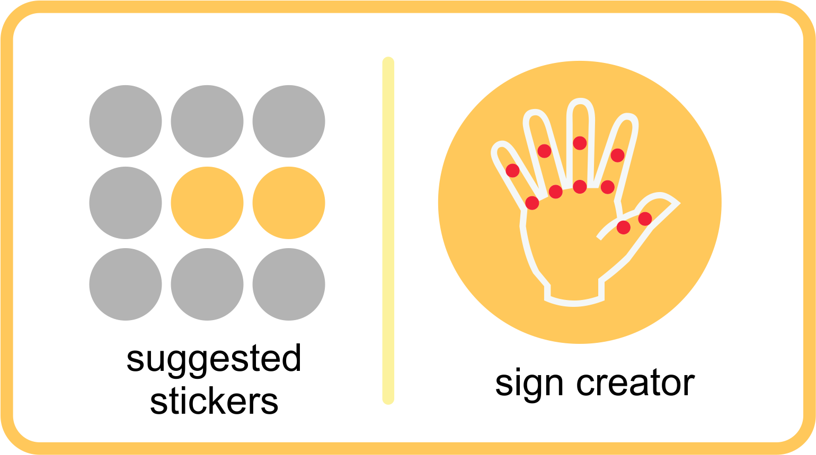
System Diagram
Chatting Procedure
gif
Sign Language
Gif Creation
D-User
User
Facebook Messenger
Text Message
Animated Stickers
2D Model
Text Message
IT 14076176 – A.M.O.P.Bandara

Slide 21
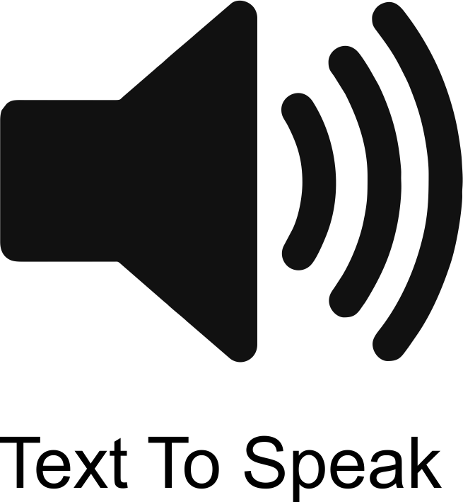
System Diagram
Voice procedure
Animated Stickers
2D Model
Voice output
User
D - User
Text Message
gif
Gif Creation
Voice input
Text Message
IT 14076176 – A.M.O.P.Bandara

Slide 22
Technical Diagram
Text Input
Voice Input
Resource Adaptor
Semantic Analysis/ Word Recognition
Internet
Speech Recognition
Action Planning/Execution
Resource Binder
Text Document
Web API
Sign Language
Natural Language Processing
Messenger
Action Planning/Execution
Persistence Storage
GIF Creator
Machine Learning
User Model
Create an Account
Chat History
Learning Sign Language
GIF
IT 14076176 – A.M.O.P.Bandara

Slide 23




Project Overview
2D Model Creation
Text Conversion
GIF Compression & Extraction
Voice Recognition Module
IT 14076176 – A.M.O.P.Bandara

Slide 24
Project Overview
2D Model Creation
Having Senses for each Finger joints with high flexibility. Hearing impaired user can bend or stretch very easily from each sense to create the user’s sign
Text Conversion
GIF
Compression & Extraction
Voice
Recognition
Module
IT 14076176 – A.M.O.P.Bandara

Slide 25
Project Overview
Text Conversion
Text input by the user is sent to a module which tries to recognize word by word through Semantic Analysis.
2D Model Creation
GIF Compression & Extraction
Voice
Recognition
Module
IT 14106866 – W.Shenali Tissera
25

Slide 26
Project Overview
Voice Recognition Module
Automatic Speech Recognition will recognize the words from the given speech. Spoken words are analyzed by a Spoken Language Understanding. Use of text-to-speech synthesis (TTS) module
2D Model creation
Text Conversion
GIF Compression & Extraction
IT 14029264 – S.Y.M.Perera

Slide 27
Project Overview
GIF Compression & Extraction
GIF files are send through the networks by compressing. The “GZIP Compression Algorithm” is used for the compression & output GIF is deliver under decompression
2D Model creation
Text Conversion
Voice
Recognition
Module
IT 14114618 – J.P.C.N. Jayalath

Slide 28
Individual Contribution
2D Model Creation
Text Conversion
GIF Compress &
Extract
Voice Recognize
IT14076176
IT14106866
IT14114618
IT14029264
A.M.O.P. Bandara
W.S. Tissera
J.P.C.N Jayalath
S.Y.M. Perera

Slide 29
Creating 2D model
Convert created 2D model sign to Text
Offline Messaging
Creating Sticker and GIFs
“Learning Signs”
IT 14076176 – A.M.O.P.Bandara

Slide 30
Individual Contribution
2D Model Creation
Text Conversion
GIF Compress &
Extract
Voice Recognize
IT14076176
IT14106866
IT14114618
IT14029264
A.M.O.P. Bandara
W.S. Tissera
J.P.C.N Jayalath
S.Y.M. Perera

Slide 31
Text to Sign Language using Semantic Analysis
Handling Sinhala & Singlish API
Interaction with Chat application “Sanwadha”
Creating Sticker and GIFs
IT 14106866 – W.Shenali Tissera

Slide 32
Individual Contribution
2D Model Creation
Text Conversion
GIF Compress &
Extract
Voice Recognize
IT14076176
IT14106866
IT14114618
IT14029264
A.M.O.P. Bandara
W.S. Tissera
J.P.C.N Jayalath
S.Y.M. Perera

Slide 33
Sign Language to GIF format conversion
Machine Learning & GZIP compression algorithm
Interaction with Messenger API
Creating Sticker and GIFs
IT 14114618 – J.P.C.N.Jayalath

Slide 34
Individual Contribution
2D Model Creation
Text Conversion
GIF Compress &
Extract
Voice Recognize
IT14076176
IT14106866
IT14114618
IT14029264
A.M.O.P. Bandara
W.S. Tissera
J.P.C.N Jayalath
S.Y.M. Perera

Slide 35
Speech Recognition
Speaker Recognition
Natural Language Processing
Creating Sticker and GIFs
IT 14029264 – S.Y.M.Perera
IT 14029264 – S.Y.M.Perera

Slide 36









Technologies we are using….
Visual Studio 2017
Xamarin
Microsoft Azure
SQLite Database
MAYA Autodesk
Photoshop CC
CorelDraw X7
Singlish API
Rest API
IT 14029264 – S.Y.M.Perera

Slide 37
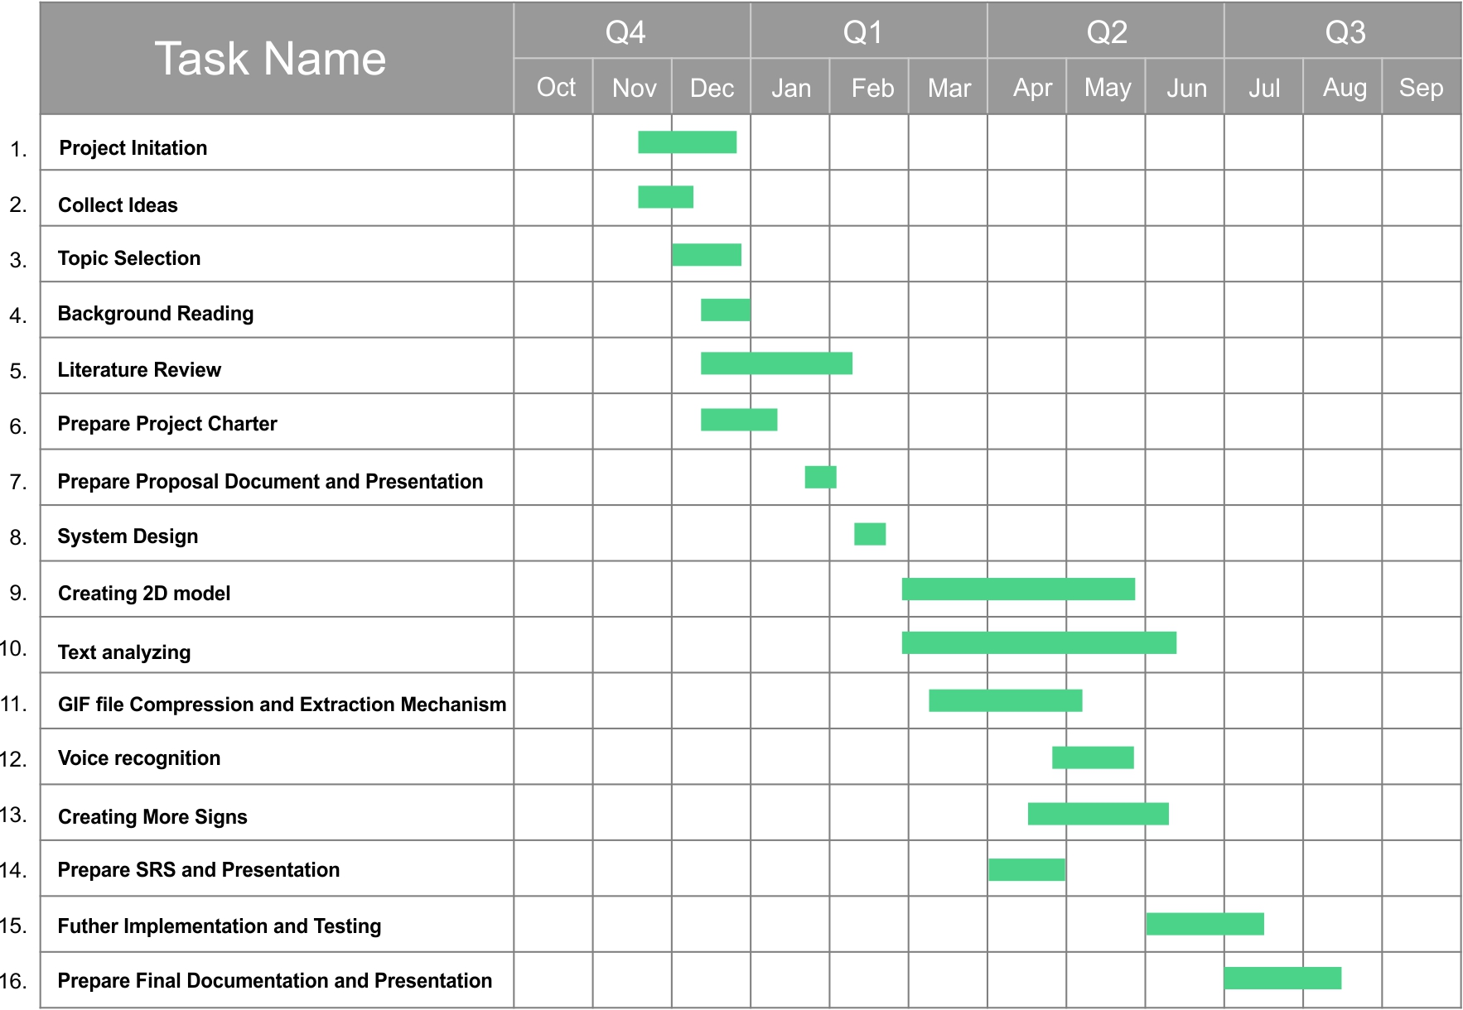
Time Frame
?
IT 14029264 – S.Y.M.Perera

Slide 38
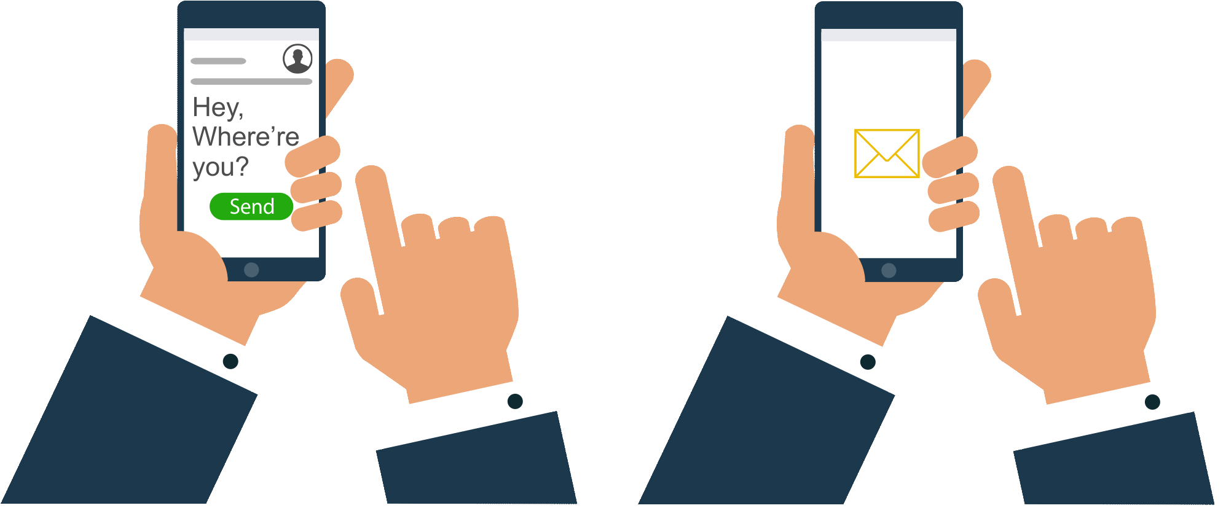
Expected Outcome
IT 14029264 – S.Y.M.Perera
38
Notes:
A Better application to make a bridge to avoid the gap between normal and hearing impairs .

Slide 39
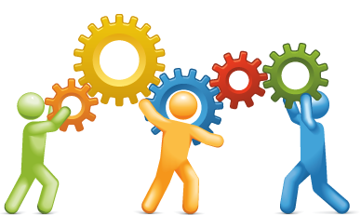
Users & Benefits
IT 14029264 – S.Y.M.Perera

Slide 40

User Groups
The proposed system will be highly useful for main three groups
Hearing impaired people.
Illiterate people or who cannot understand English textual content.
Regular users.
?
IT 14029264 – S.Y.M.Perera

Slide 41
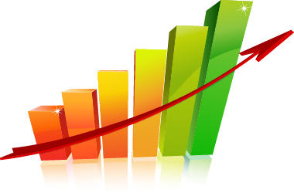
Benefits
Help hearing impaired people to communicate themselves once they are in distance.
Help to link hearing impaired people with ordinary people.
To fully integrate the Hearing impaired individuals in the society.
Avoids too much texting in chatting.
Make message sending effective.
Availability of offline messaging.
IT 14029264 – S.Y.M.Perera

Slide 42
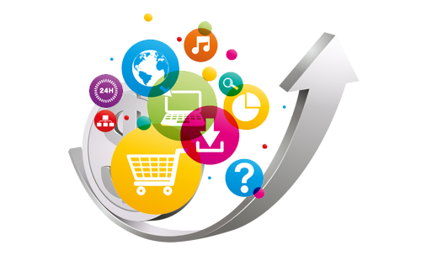
Business Pitch
Why should use this app ?
What is the market Space ?
?
Application will save the time of the user.
As an education supportive tool. (Learning sign language)
This application survive in the market for a far more life time.
No limitations for the user ex: age, regular or hearing impaired
They can use the application anywhere at anytime.
IT 14029264 – S.Y.M.Perera
42

Slide 43

Business Pitch
How do we earn revenue ?
?
Government funds via special projects (MOH, Ministry of IT, ICTA).
Invest through Independent Software Vendors (ISV) in Private Companies.
Endorse through Health Care exhibitions & offering trial accounts.
Digital Marketing (Facebook , Twitter, Linked In).
Give a premium model and then supply additional services.
Forming partnership with companies (Microsoft & Facebook).
Q
43
IT 14029264 – S.Y.M.Perera

Slide 44
Q & A

Slide 45
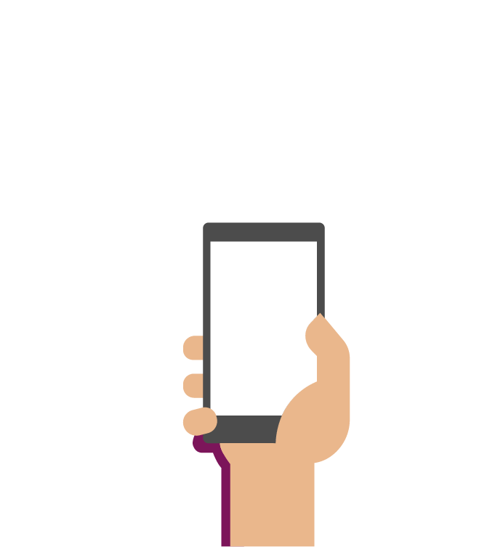
communication
Download
HAPPY
Thank You !!

Slide 46
Thank You !!

